Slide 1
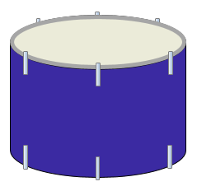
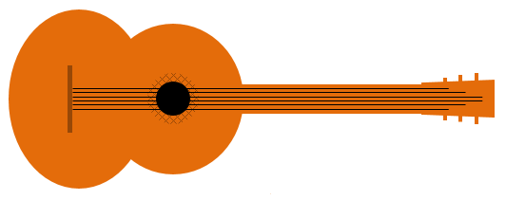
Sound vibrations
When something vibrates it can make a sound.
A vibration is a shake or a wobble.

Slide 2
Sound vibrations
What vibrates to make a sound?
I am sure this is right
I think this is right
I think this is wrong
I am sure this is wrong
A
The guitar strings
B
The skin on the drum
C
The metal in the horn
D
The air in the horn

